Slide 1


R for Movement Ecologists: Species Distribution Models
Image credit:
Nicolas Winkler
OTN Early Career Researcher Workshop
Reid Steele and Esteban Salazar
Slides by Derek Tittensor

Slide 2

Workshop Structure
Intro to Species Distribution Models (SDMs)
SDM Data and Formatting
SDM Statistics and Theory
Considerations for SDMs using Acoustic Telemetry

Slide 3

Coding Sections
Format and Visualize Acoustic Data
Make Environmental Data Rasters
Reformat to biomod2 Data Format
Running Species Distribution Models
Evaluating Species Distribution Models
Ensemble Modelling

Slide 4
Introduction to Species Distribution Models
Image credit:
Nicolas Winkler

Slide 5

Species distribution modelling (ecological niche modelling)
Relate the distribution of a species to the environment
Can then project in space and/or time

Slide 6
How do SDMs work?
Species occurrences
Statistical models relating species occurrences (sometimes also absences) to environment)
Environmental variables
Modelled distribution
Model future distribution
Notes:
Focussing on the impacts of temperature:
Biodiversity research frequently focusses on range shifts
Moving from species range shifts to ecosystem changes

Slide 7
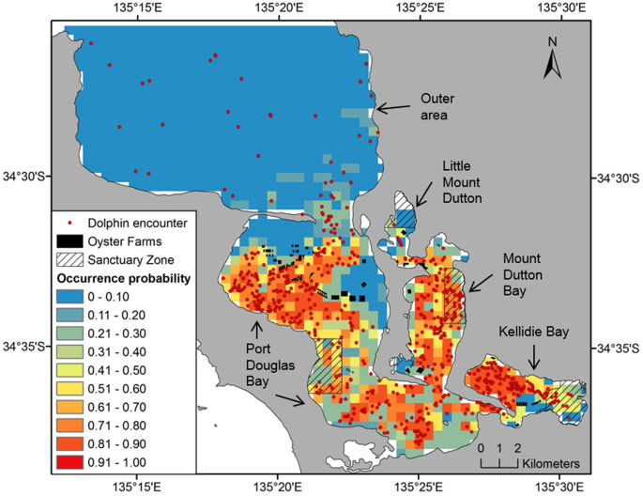
SDMs and conservation
Overlaying SDMs with protected areas
How much is covered now?
How much will remain covered?
Using SDMs to help site PAs
How about SDMs for more dynamic conservation?
Passadore et al. (2018), Sci. Rep.

Slide 8
SDM Data and Formatting
Image credit:
Nicolas Winkler

Slide 9

Basic SDM data requirements
(1) Geo-referenced observations of species presences (+ absences?)

Slide 10
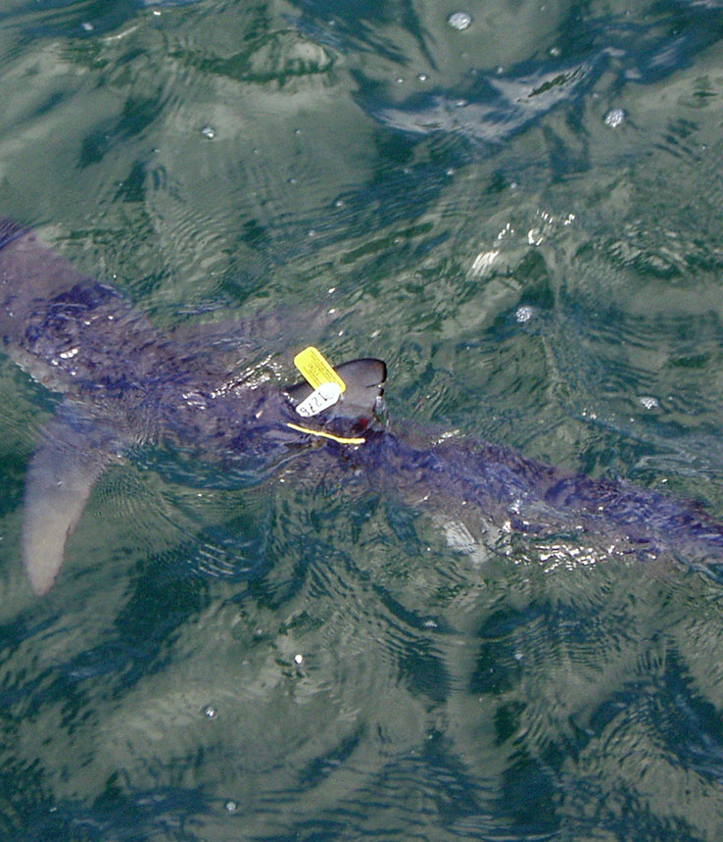
(1) Geo-referenced observations of species presences (+ absences?)
Species occurrence databases
Global Biodiversity Information Facility (GBIF), Ocean Biodiversity Information System (OBIS)
Query via R geodata package
Tagging Data
Satellite Tagging (e.g. PSAT, SPOT, MiniPAT)
Acoustic Tagging

Slide 11
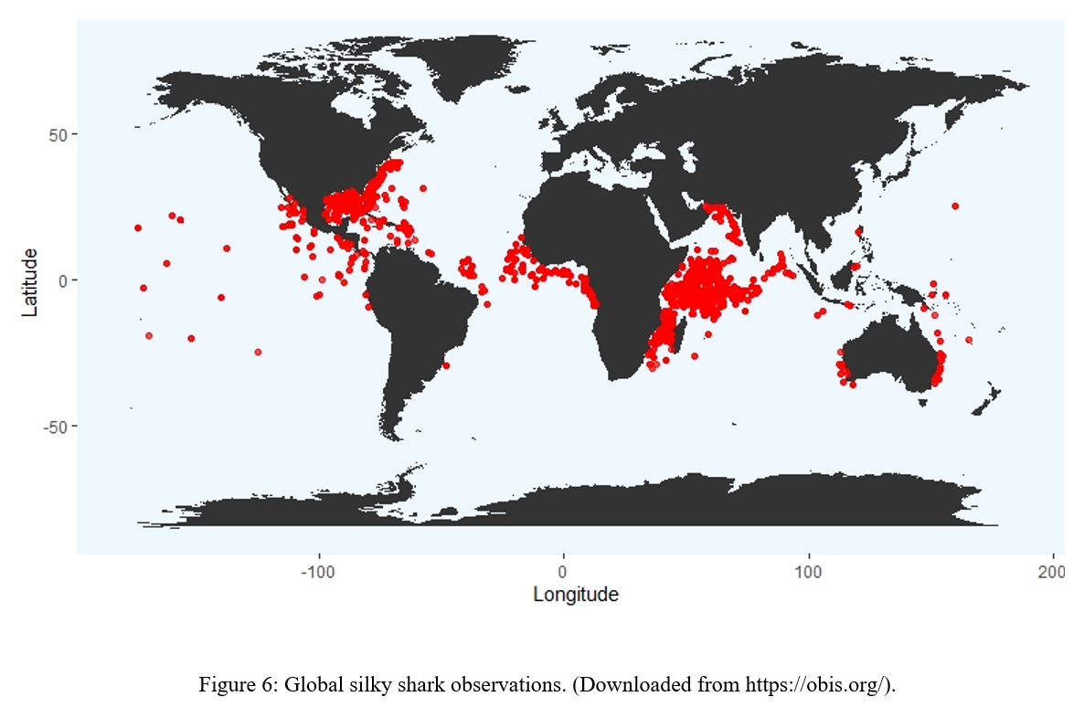
Global data from e.g. OBIS
No (or unreliable) date
Cannot precisely match to environmental conditions
Instead use a climatology – ‘average’ environment at that place
This may be very different from the conditions that a species actually experiences
Salazar et al. (in prep.)
Salazar et al. (in prep.)

Slide 12
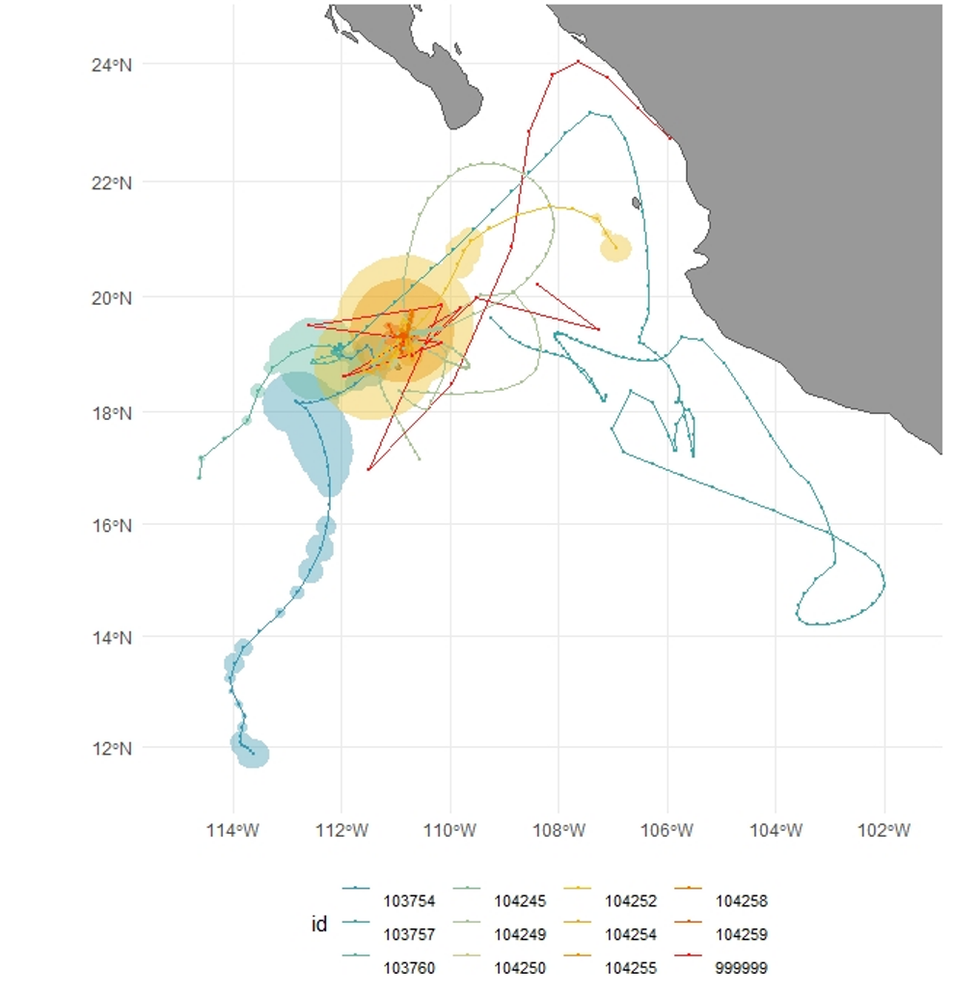
Regional tagging data
Precise date (and location)
Can match very precisely to actual environmental conditions experienced by a species
However, may not capture the whole range of conditions experienced by a species (‘niche’)
Salazar et al. (in prep.)

Slide 13
Coding Sections
Format and Visualize Acoustic Data

Slide 14
Basic SDM data requirements
(1) Geo-referenced observations of species presences (+ absences?)
(2) Gridded environmental data layers (e.g. chlorophyll, SST, oxygen)

Slide 15
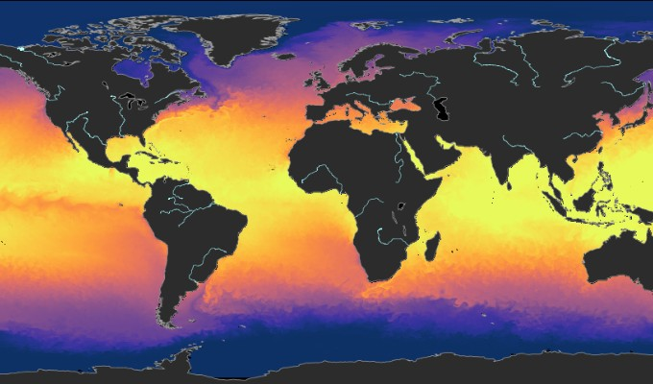
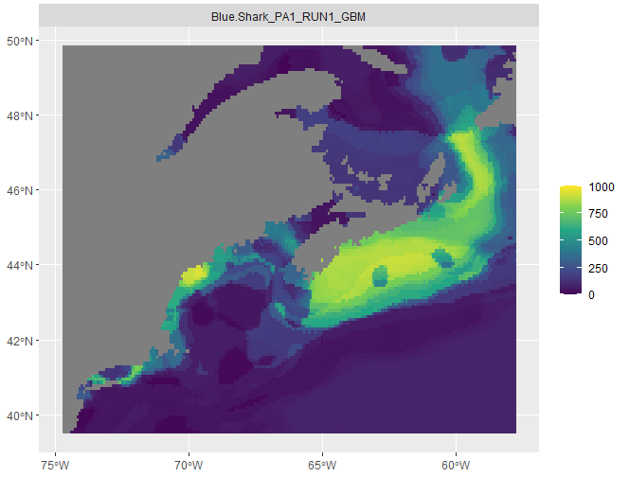
(2) Gridded environmental data layers (e.g. chlorophyll, SST, oxygen)
Bio-ORACLE
Decadal, 0.05° resolution (~5.5km)
Query with geodata or biooracler
NOAA ERDDAP
Varying spatial/temporal coverage
Query with rerddapXtracto
Copernicus Marine
Hourly to monthly, 0.0833° resolution (~8km)
Query with CopernicusMarine
NOAA World Ocean Atlas
CMIP 6 Archive

Slide 16
Coding Sections
Format and Visualize Acoustic Data
Make Environmental Data Rasters

Slide 17
Basic SDM data requirements
(1) Geo-referenced observations of species presences (+ absences?)
(2) Gridded environmental data layers (e.g. chlorophyll, SST, oxygen)
(3) A statistical method that links species to environment (and projects to locations where species is not observed)

Slide 18
SDM Statistics and Theory
Image credit:
Nicolas Winkler

Slide 19
Methods for SDM statistical modelling
Envelope and distance-based approaches
e.g.
SRE (aquamaps)
ENFA
Regression-based approaches
e.g.
Generalized linear model (GLM)
Generalized additive model (GAM)
Machine-learning/ other approaches
e.g.
Artificial neural network (ANN)
Maximum entropy (maxent)

Slide 20
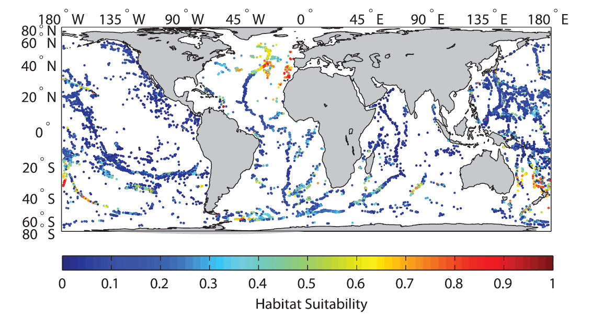
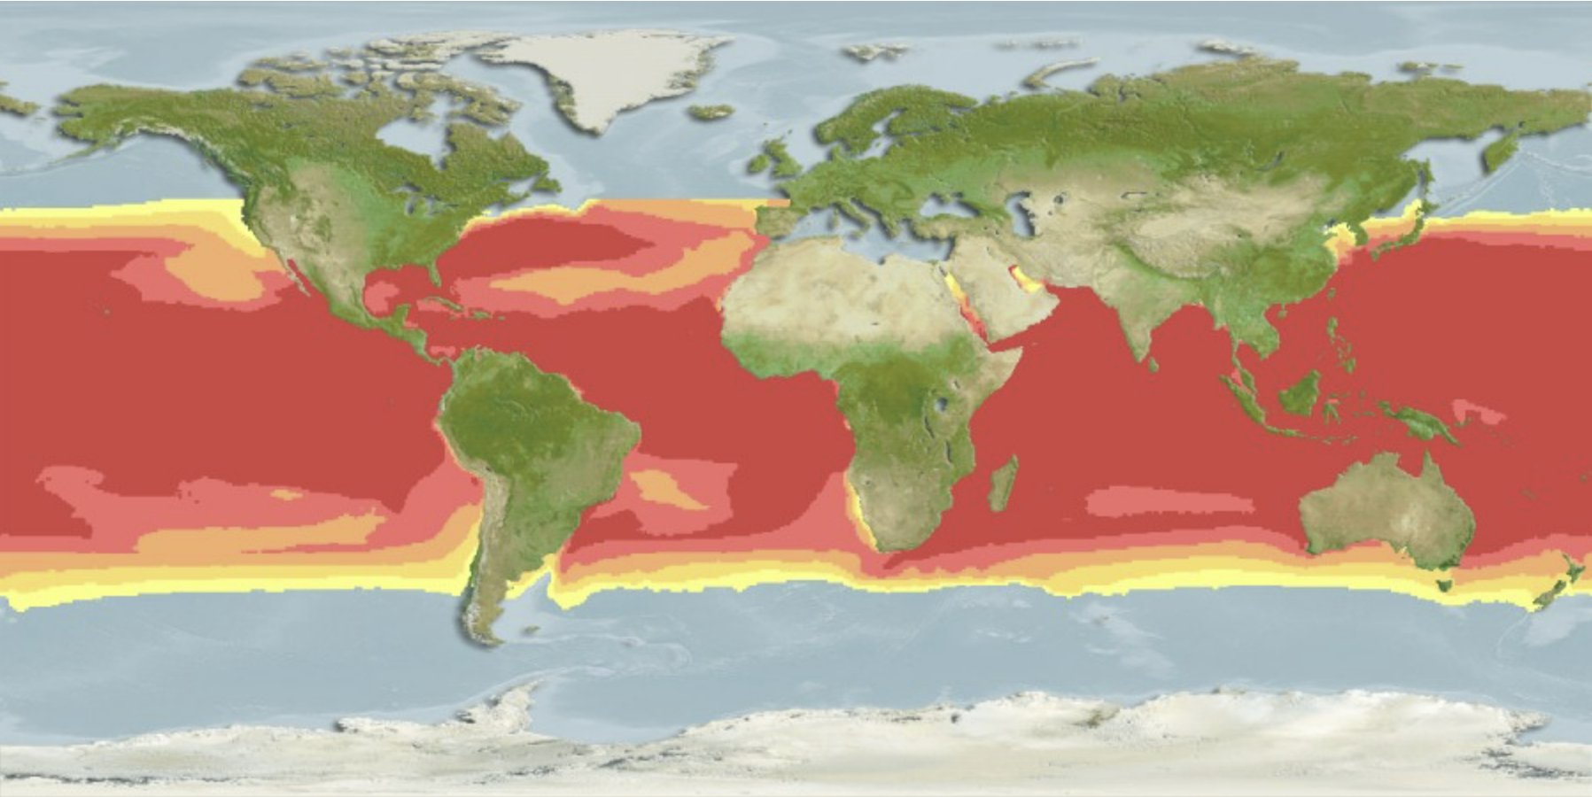
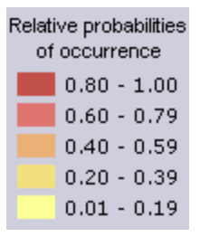
Examples
Cold-water stony corals on seamounts (Maxent)
Rhincodon typus (RES)
Tittensor et al. (2009)
Aquamaps.org ; Ready et al. (2010)

Slide 21
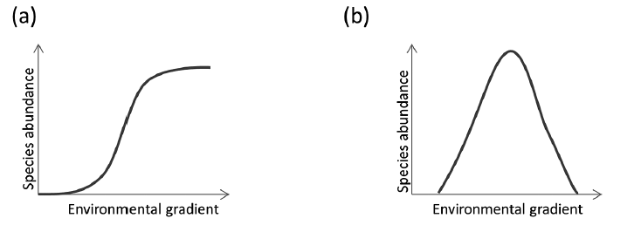
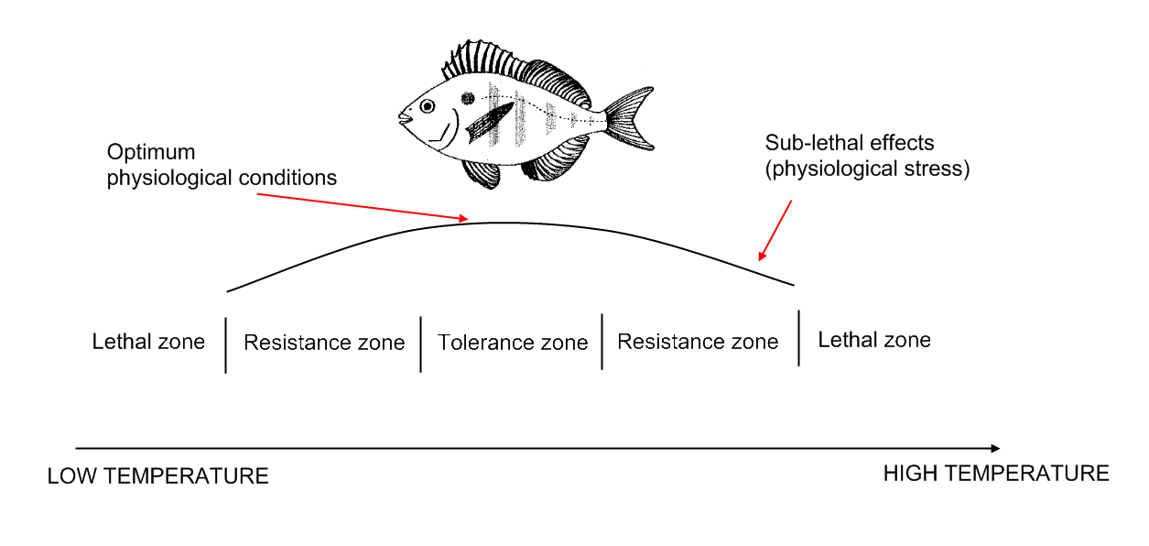
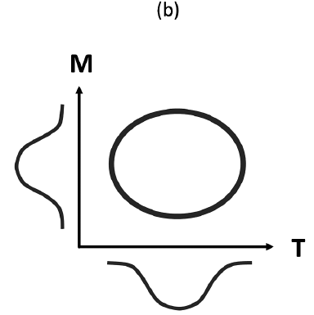
Species niches
P
Bennett & Judd (1992)

Slide 22
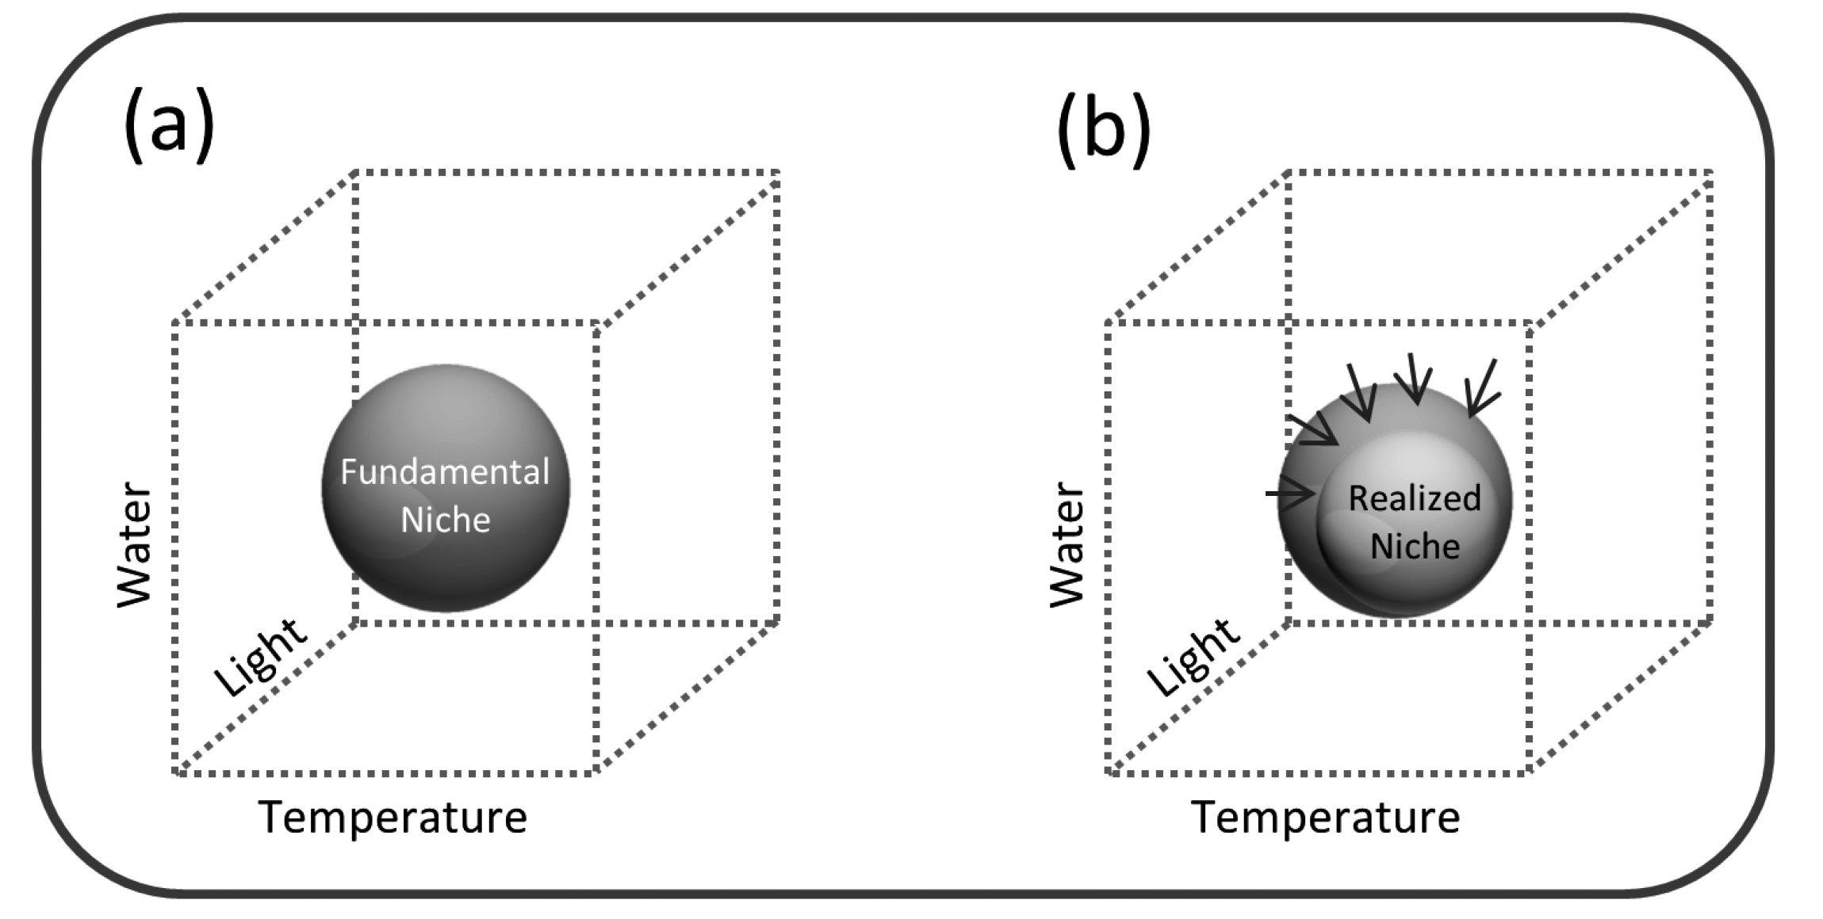
Fundamental vs. realized niche

Slide 23
Fundamental vs. realized niche

Slide 24
Geographic space and niche space
Geographic space is the area of study
Niche space is the environmental conditions occupied by the species
Environmental space is the range of environmental conditions in the area of study
Most methods do not explicitly consider geographic space
Try to move your thinking from geographic space into niche space when using SDMs

Slide 25

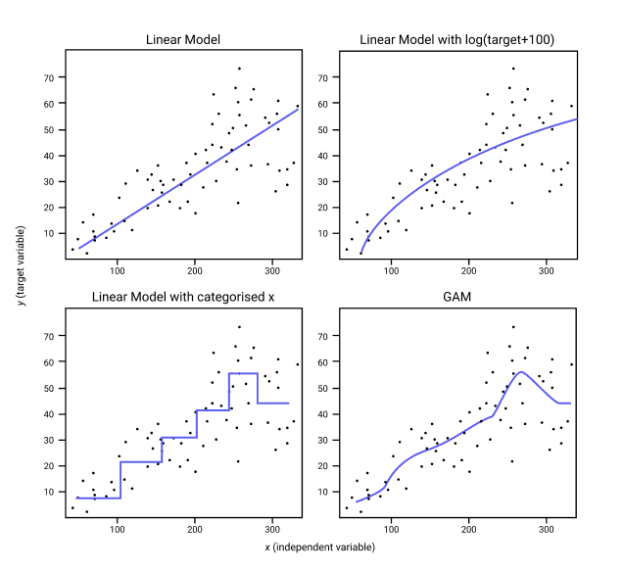
Algorithms used
GLM
GAM
RF

Slide 26
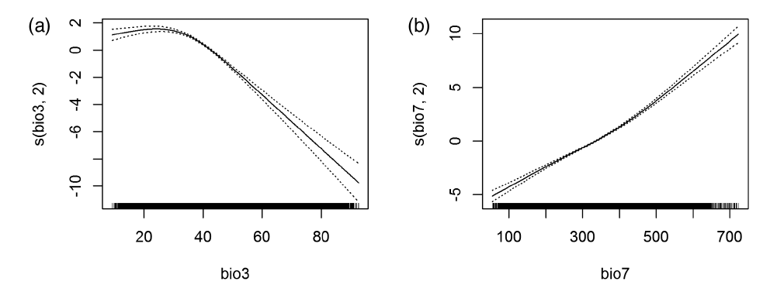
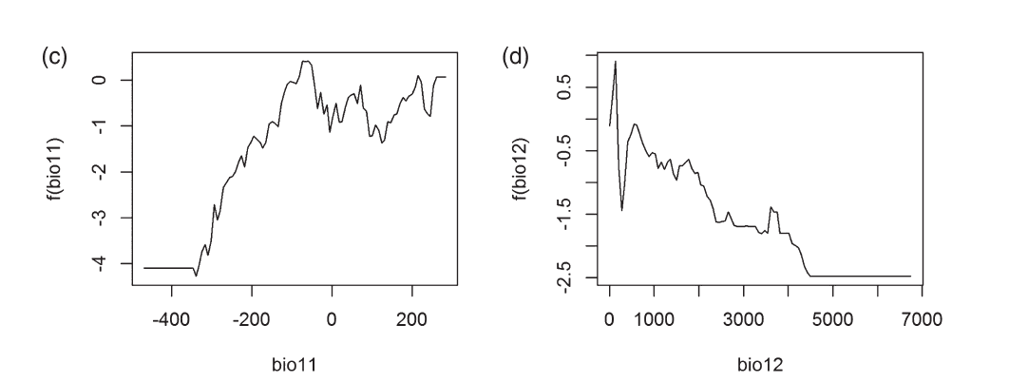
Important: differences between methods in terms of how they fit
Probability of
occurrence
Probability of
occurrence
Environmental variable (e.g. chlorophyll)

Slide 27
Coding Sections
Format and Visualize Acoustic Data
Make Environmental Data Rasters
Reformat to biomod2 Data Format
Running Species Distribution Models

Slide 28
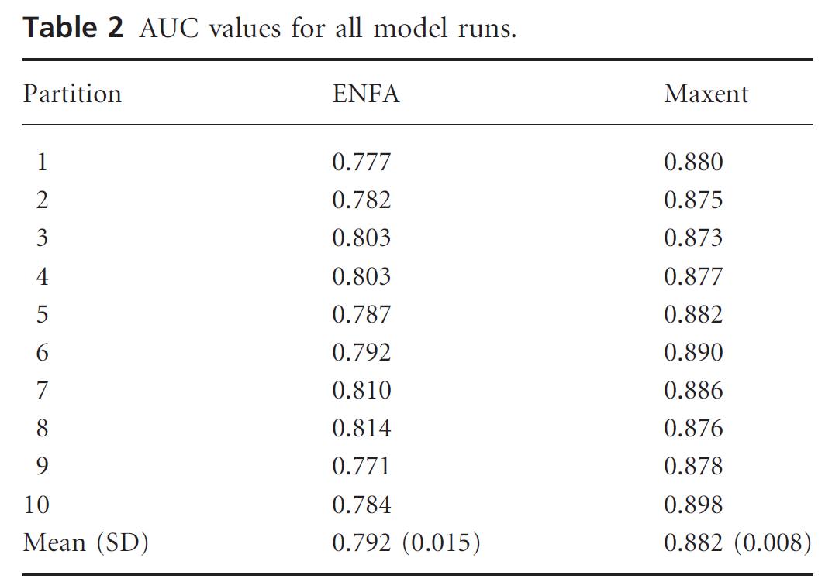
Assessing model performance
Often use AUC (area under curve)
Other measures available (e.g. TSS)
Tittensor et al. (2009)

Slide 29
Metric evaluations
Real values
Presence
Absence
True Positive | False Positive
False Negative | True Negative
Presence
Predicted Values
Absence
0.5 = random
0.6 - 0.7 = poor performance
0.7 - 0.8 = good performance
0.8 - 1.0 = excellent performance
Sensitivity
True Positives
Specificity
True Negatives
True Sensitivity and Specificity
(TSS)
Receiver Operating Characteristic
(ROC)

Slide 30
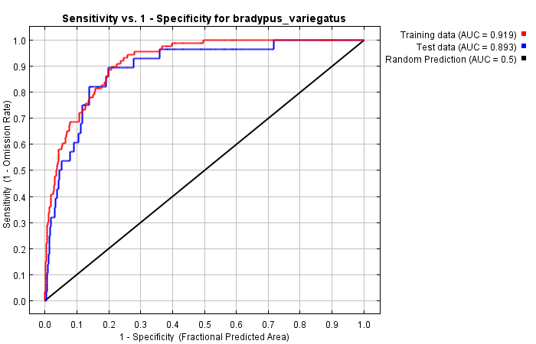
Receiver-operating characteristic curve (ROC)
ROC curve plots sensitivity against (1-specificity)
(1 – specificity) is proportion of absences incorrectly predicted as presences
AUC summarizes ROC curve into a single value
TRUE POSITIVES
FALSE POSITIVES

Slide 31
True Skill Statistic (TSS)
TSS is: sensitivity + specificity – 1
This value depends on the threshold chosen
Optimal threshold for calculating TSS is used
In general, the value that maximizes sensitivity + specificity
A value >0.5 or >0.6 is considered a good score

Slide 32
Cross-validation and over-fitting
A model that fits perfectly to your data may not be the best model for prediction
‘Overfitting’
Use cross-validation to prevent this
Separate data into ‘training’ and ‘test’ data

Slide 33
Cross-validation
K – fold CV
1
2
3
4
5
Test
1
2
3
4
5
Train
1
2
3
4
5
1
2
3
4
5
1
2
3
4
5
Train
Test
Train
Train
Test
Train
Train
Test
Train
Train
Test

Slide 34
Key assumptions / challenges
Species occurrences
Observations of species span full range of suitable conditions
Steady-state relationship with environment
All key predictors included
Three-dimensional environment
Model layers (e.g. surface, seafloor)
Can be challenges with getting sub-surface environmental data
Environmental variables
Modelled distribution

Slide 35
Coding Sections
Format and Visualize Acoustic Data
Make Environmental Data Rasters
Reformat to biomod2 Data Format
Running Species Distribution Models
Evaluating Species Distribution Models

Slide 36
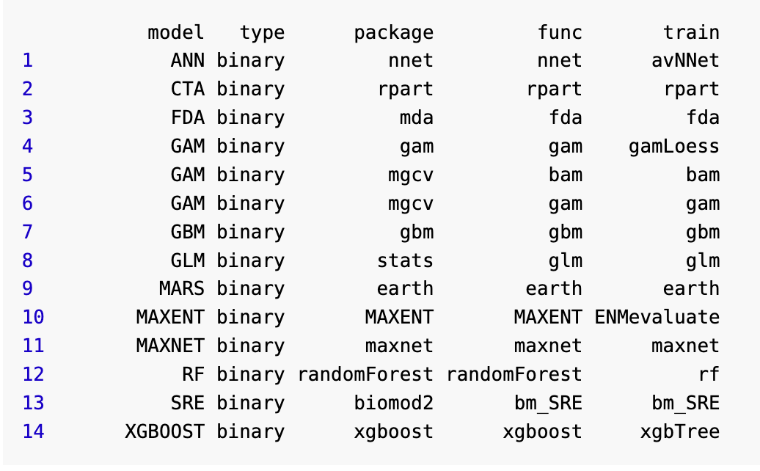
Ensemble modelling
Sometimes results from multiple algorithms are combined
Called an ensemble
Weighted/unweighted
How to weight ensemble models?
Biomod user manual

Slide 37
Algorithms used
GLM
GAM
Ensemble
Unweighted
Random
Forest
GLM
GAM
Ensemble
Weighted
Random
Forest

Slide 38
Coding Sections
Format and Visualize Acoustic Data
Make Environmental Data Rasters
Reformat to biomod2 Data Format
Running Species Distribution Models
Evaluating Species Distribution Models
Ensemble Modelling

Slide 39
Considerations for SDMs using Acoustic Telemetry
Image credit:
Nicolas Winkler

Slide 40
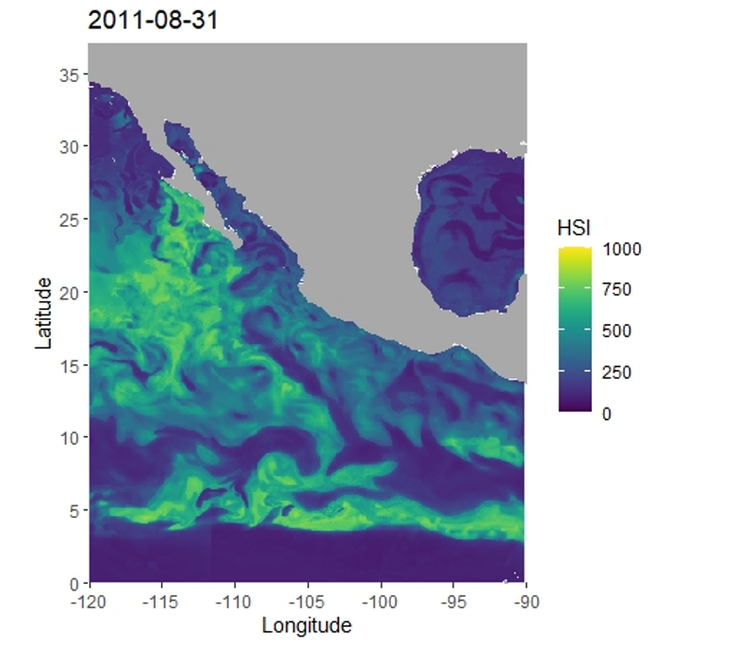
SDM based on tagging data
May truncate niche
Potentially big problem, especially for climate change projections
Niche may vary within a species
Conditions experienced globally
Conditions experienced in ETP
Conditions experienced at receivers
Temperature
Salazar et al. (in prep.)

Slide 41

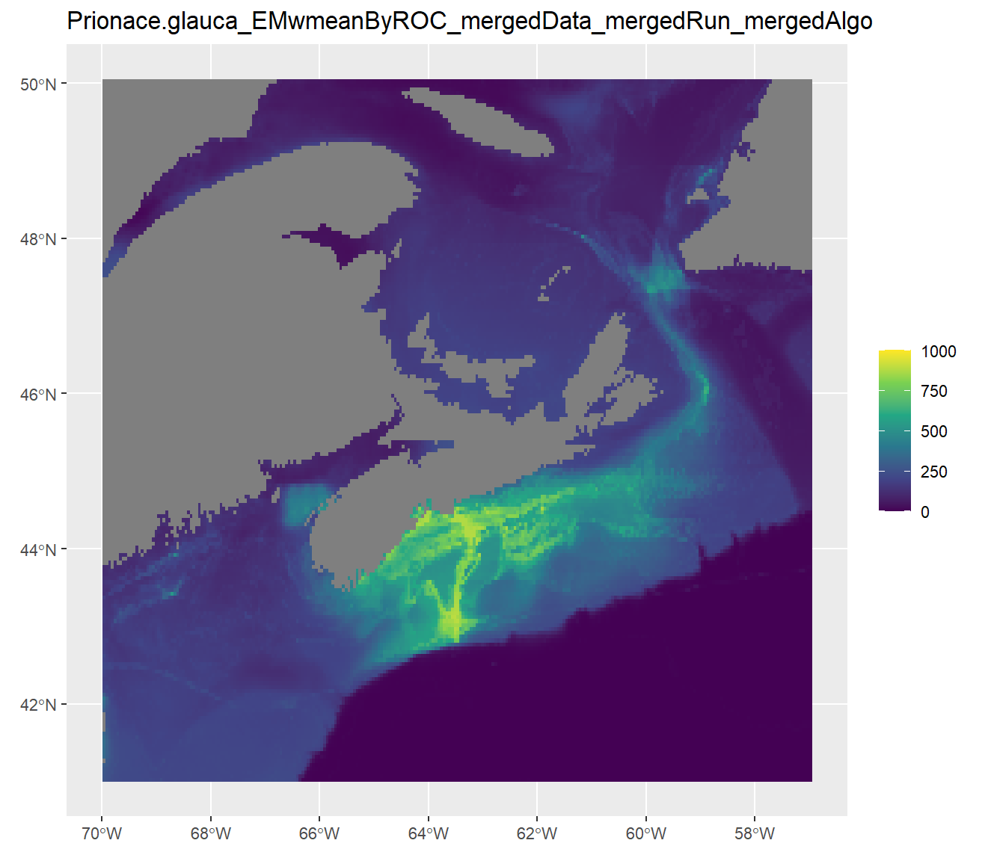
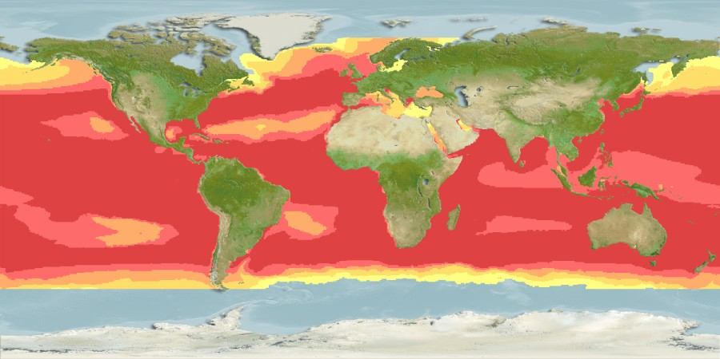
Acoustic Data Challenges
Niche is heavily truncated
Generally only cover small subset of range and conditions experienced
Receiver layout may bias output
Generally not ideal for making SDMs

Slide 42
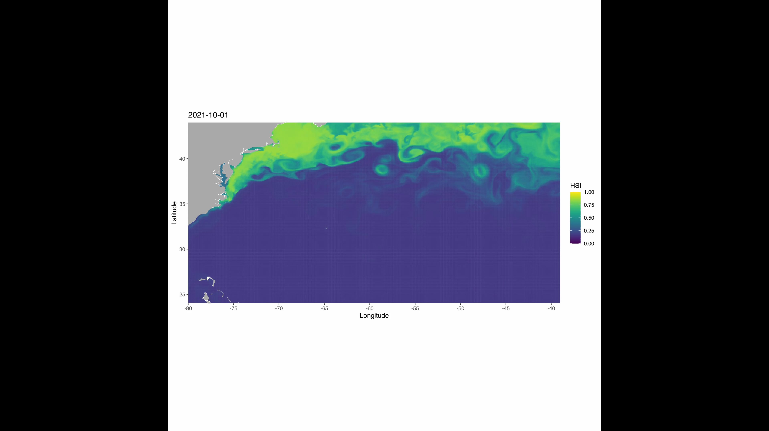
Acoustic Data Uses
Independent validation dataset for SDMs from satellite or global occurrence data
Hyper-local scenarios where full niche can be captured with acoustic receivers
Dynamic SDMs which account for time
Salazar et al. (in prep.)

Slide 43
Questions?
Thanks to:
Derek Tittensor
Ocean Tracking Network
FOME Lab Members
Audience!

Slide 44
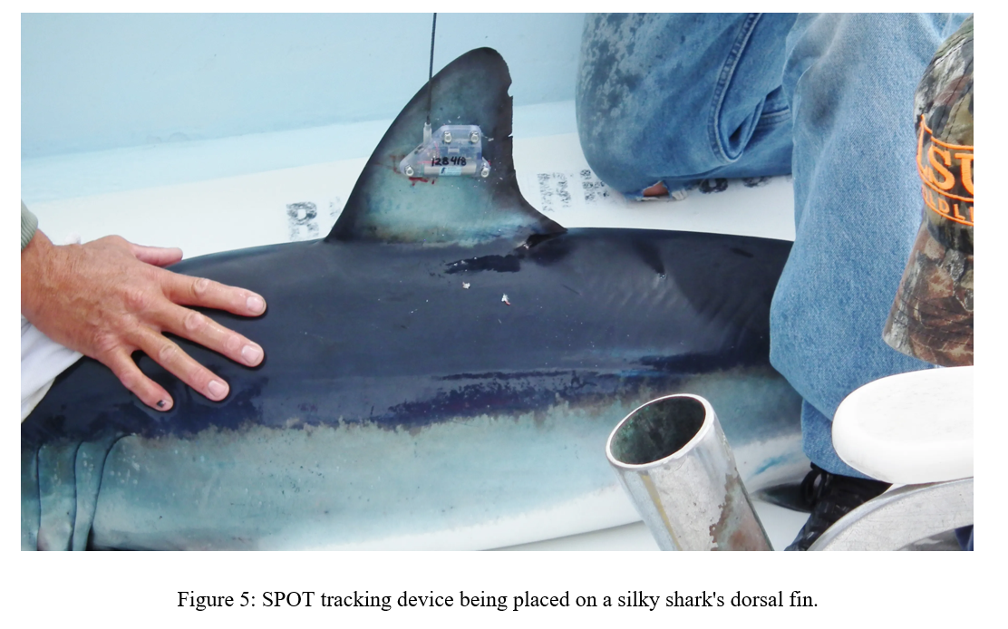
Practical solution
Recognize that model developed at regional scale (using tagging data) is telling you something different from a global model
No practical way around this without global tagging data set?
Be very careful making projections using regional tagging data

Slide 45
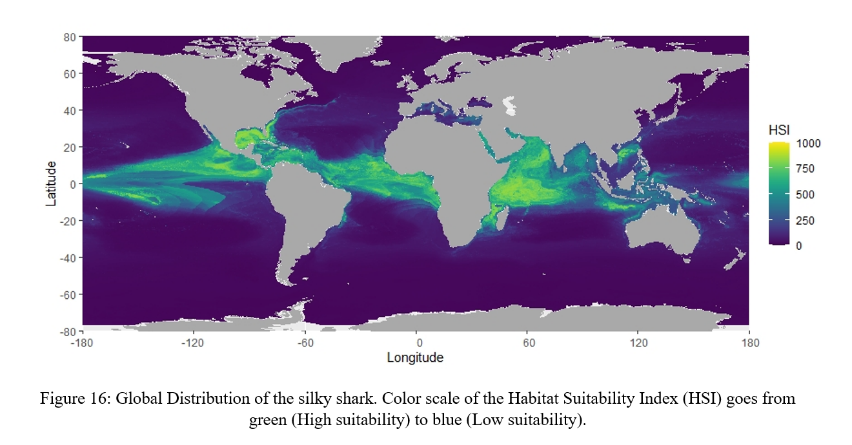
SDM based on global data
Should not truncate niche
Does not match to exact environment
Will not pick up importance of local-scale, high-frequency features
Will inevitably give a different result to a local SDM
Salazar et al. (in prep.)

Slide 46
Generalized linear models (GLMs)
glm1 <- glm(VulpesVulpes ~ 1 + bio3 + bio7 + bio11 + bio12,
data = mammals_data, family = “binomial”)
-> i.e. a logistic regression

Slide 47

Logistic Regression
Binary response data
Want probability P of species presence
(probability of absence is 1-P)
Translates to habitat suitability
Remember not a true probability without absence data

Slide 48
Fit logistic regression using GLM and binomial error distribution
Linear predictor
Y= 1/(1+e ^{β0+β1}·^{X})
Relative probability of species presence
Link function
log(Y / (1 - Y)= β0+β1·X
Predictor variable
Notes:
GLM function in R takes care of all of this.

Slide 49
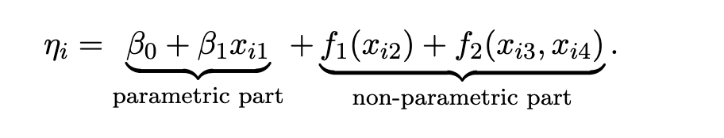
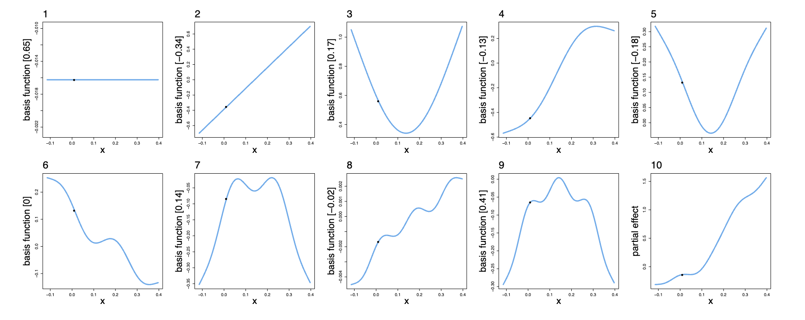
Generalized Additive Models (GAMs)
Smoothing splines
Linear predictor
Smoothers penalized with cost function
Basis functions (elementary curves)
Sum of basis functions ( i.e. f_{i} )

Slide 50
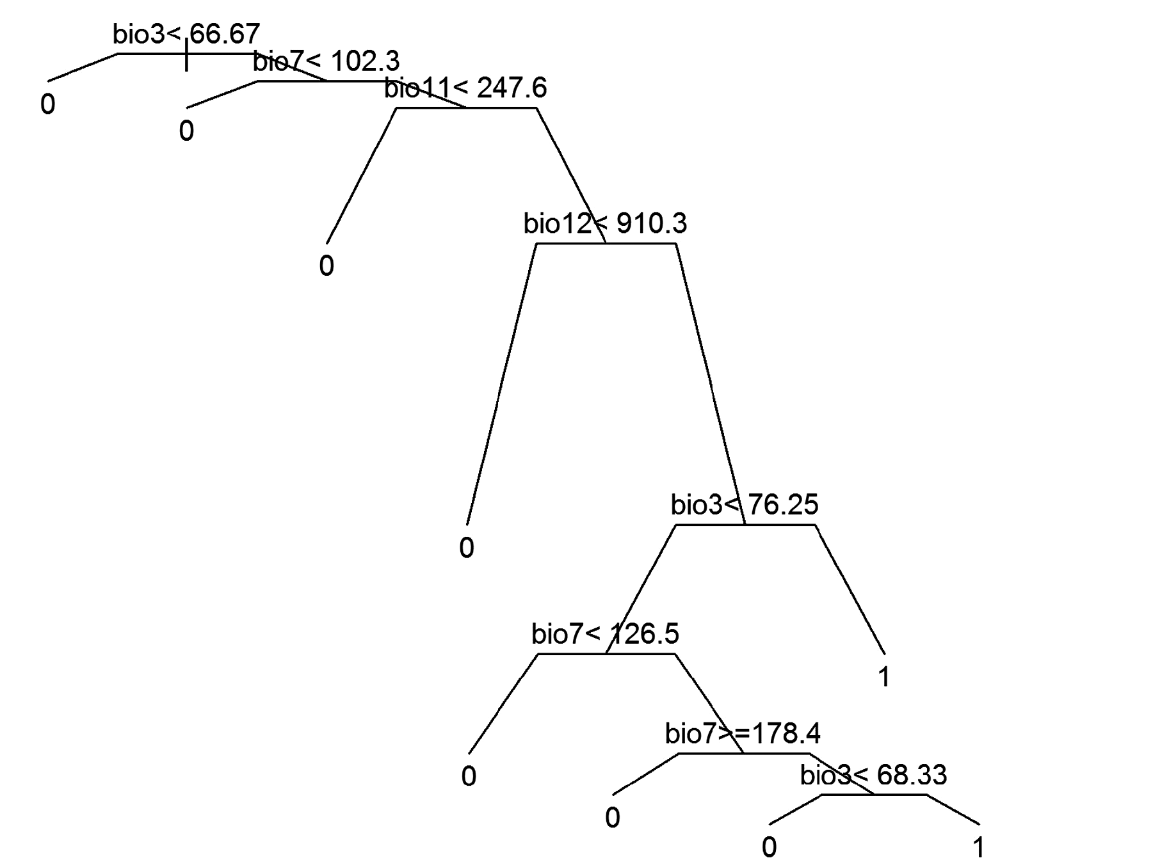
Random forest
Random forest approach uses recursive partitioning to create a ‘tree’
Then creates multiple ‘trees’ over bootstrap samples of the data

